Slide 1
Digital Portfolio
STUDENT NAME:DEVASHREE B
REGISTER NO : 2428B0306
NMID : 5FC704B1922E2379F8845C385B44B66C
DEPARTMENT :BSC.COMPUTER SCIENCE WITH DATA ANALYTICS
COLLEGE : KPR COLLEGE OF ARTS SCIENCE AND RESEARCH
UNIVERSITY : BHARATHIAR UNIVERSITY

Slide 2
PROJECT TITLE
Creative Portfolio Website – Showcasing Drawing, Writing, and Designing

Slide 3


AGENDA
Problem Statement
Project Overview
End Users
Tools and Technologies
Portfolio design and Layout
Features and Functionality
Results and Screenshots
Conclusion
Github Link
3/21/2024 Annual Review

Slide 4

PROBLEM STATEMENT
In today’s digital era, traditional resumes and academic documents are insufficient to showcase an individual’s creativity and technical skills. Students and creative professionals struggle to present their works such as drawings, writings, and designs in a professional, organized, and accessible format.
There is a clear need for a personal digital portfolio that highlights not only academic and technical achievements but also creative talents, providing a single platform for employers, peers, and the general audience to evaluate both creativity and capability.

Slide 5

PROJECT OVERVIEW
The Creative Portfolio Website is a personal web-based platform developed to present my academic background, technical expertise, creative works, and projects in a structured and professional manner.
The portfolio includes well-defined sections – About Me, Skills, Education, Projects, Creative Works, and Contact – designed with HTML, CSS, and JavaScript to ensure a responsive, clean, and user-friendly experience.
Beyond being a digital resume, this portfolio emphasizes creativity, innovation, and personal branding, helping recruiters, peers, and audiences gain a holistic view of my skills and capabilities.

Slide 6

WHO ARE THE END USERS?
Students & Fresh Graduates
To showcase their academic journey, skills, and creative works in a professional manner.
Recruiters & Employers
To evaluate both the technical and creative abilities of candidates beyond a traditional resume.
Creative Professionals
Writers, artists, and designers who want to present their work portfolios digitally.
Peers, Teachers & Mentors
To review projects, provide feedback, and track creative/academic growth.
General Audience
Anyone interested in exploring the creator’s talents, writings, or artworks.

Slide 7

TOOLS AND TECHNIQUES
1.Frontend Technologies
HTML5 → For structuring the content and sections of the website.
CSS3 → For styling, layout design, and responsiveness.
JavaScript → For interactivity, form validation, and dynamic behavior.
2.Development Environment
Visual Studio Code (VS Code) → As the primary code editor.
3.Version Control & Deployment
Git & GitHub → For source code management and collaboration.

Slide 8
PORTFOLIO DESIGN AND LAYOUT
Header
Displays name, role, and contact details.
Uses a gradient background for visual appeal.
Navigation Bar
Provides quick links to different sections: About, Skills, Education, Projects, Works, Contact.
About Section
Short introduction about me, highlighting passion and creative interests.
Skills Section
Divided into Technical Skills (HTML, CSS, JS, Python, SQL, Analytics)
and Creative Skills (Drawing, Writing, Designing, UI/UX).
Education Section
Academic background with institution names and years of study.
8

Slide 9
6.Projects Section
Highlights academic and personal projects with descriptions.
7.Creative Works Section
Subdivided into Drawing 🎨, Writing ✍️, Designing 🖌️.
8.Contact Section
Includes a contact form with name, email, and message fields.
JavaScript used for form validation & feedback alert.
9.Footer
Contains copyright information and quick contact link.

Slide 10
FEATURES AND FUNCTIONALITY
1.Responsive Design
Works smoothly on desktops, tablets, and mobile devices using flexible layouts and CSS grid.
2.Interactive Navigation
A fixed navigation bar with smooth scrolling to different sections.
3.Creative Works Showcase
Categorized cards for Drawing, Writing, and Designing to highlight creativity.
4.Skills & Education Display
Clear separation of technical skills and creative skills, along with academic background
5.Projects Section
Showcases academic and personal projects with short descriptions.
6.Contact Form
Simple form for visitors to send messages.
Includes JavaScript validation and confirmation alert.
7.Modern UI Elements
Hover effects on cards, gradient header, soft shadows, and rounded corners for a professional look.
8.Easy Deployment
Can be hosted on GitHub Pages or Netlify for public access.

Slide 11
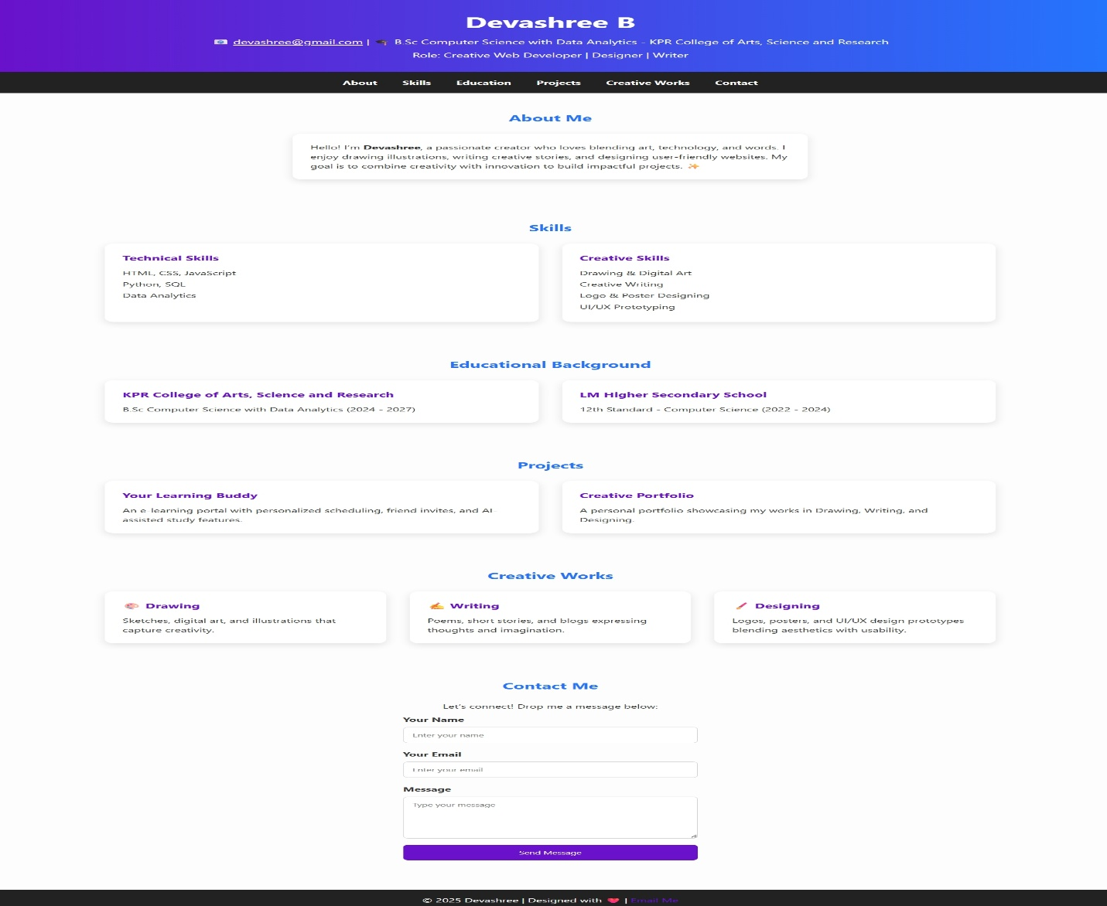

RESULTS AND SCREENSHOTS
A fully responsive Creative Portfolio Website was developed using HTML, CSS, and JavaScript.
It showcases About, Skills, Education, Projects, and Creative Works in a clear and professional layout.
Interactive features like hover effects, navigation, and a contact form enhance usability and presentation.
3/21/2024 Annual Review
11

Slide 12
CONCLUSION
The Personal Digital Portfolio project provides a professional and organized platform to showcase an individual’s skills, achievements, and creativity. Unlike traditional resumes, it allows users to present projects, writings, designs, and accomplishments in a visually appealing and structured format.
Key highlights include a user-friendly interface, responsive design, personalized sections, and easy navigation, all built with modern web technologies for a seamless experience.
The project benefits society by empowering students, professionals, and creatives to display their talents effectively, enhancing opportunities for education, employment, and collaboration. It promotes personal growth, professional development, and a more skill-aware, connected community.
12

Slide 13
Github link
https://devashree75.github.io/nmportfolionew/

